Slide 1

ENGINEERING COLLEGE JHALAWAR
SCARA Robotic Arm V2
(Final Year Project)
Supervisor:- Submitted by:-
Mr. Manoj Mittal Devansh Pahadiya
Assistant Professor Kapil Uniyara
Pranjal Mittal
Department of Mechanical Engineering

Slide 2
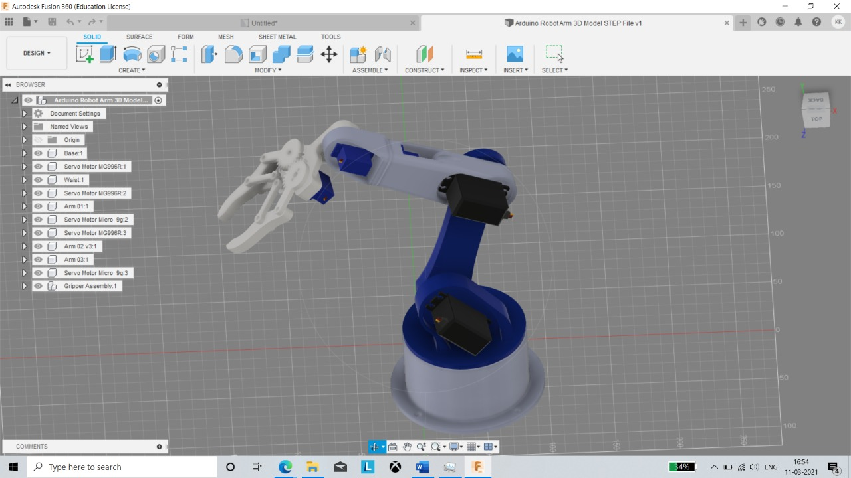
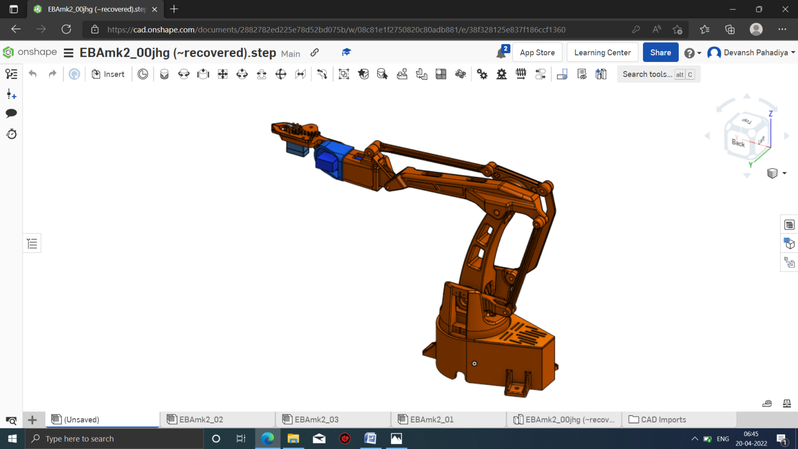
V1 V2

Slide 3
CONTENT
What is SCARA Robotic Arm
Modifications
Currents Functions
3d Model
Circuit Diagram
3d Printing
C language
Construction
Bibliography

Slide 4
What is SCARA Robotic Arm
The machine vision system will determine the pose of the object with respect to the manipulator base frame.
The robot is expected to sort objects based in their colour and precise, accurate repeatable picking and placing missions.
In many industrial applications that require fast picking and placing operations, there is a need for such a robot.

Slide 5
Modifications
Reducing the Load on the servo motors with the concept mechanical Advantage.
Giving the manual control with help of joystick
Giving the wireless manual control with the help of IR Remote.
In waist gear ratio is used to reduce the load.
In shoulder & elbow the lever system is used to reduce the load.
Improvising the body structure so that it require less material to 3d print.
Providing Display Screen for easy control of the robotic arm

Slide 6
Current Functions
Manual Control via Joystick module
Pick & Place with the help of ultrasonic sensor
Wireless Control with help of IR Remote

Slide 7
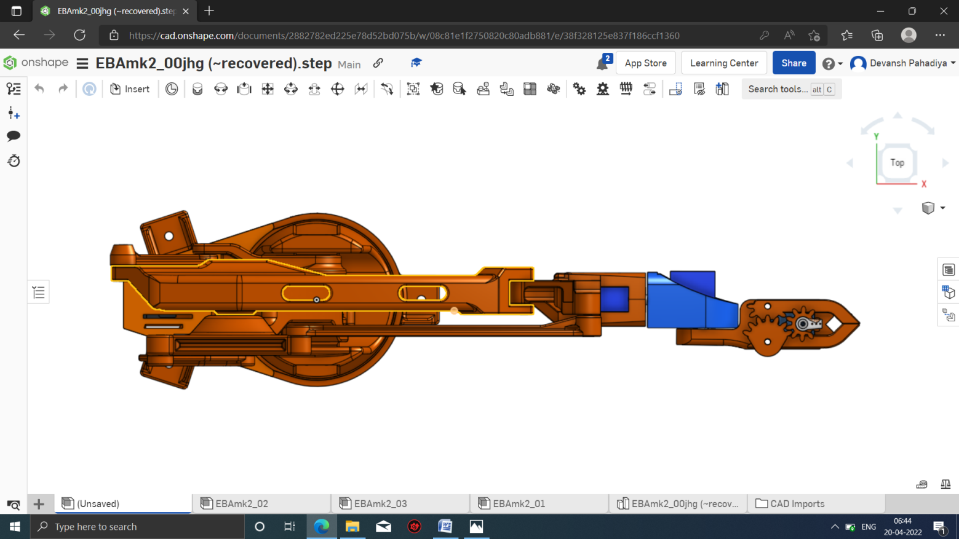
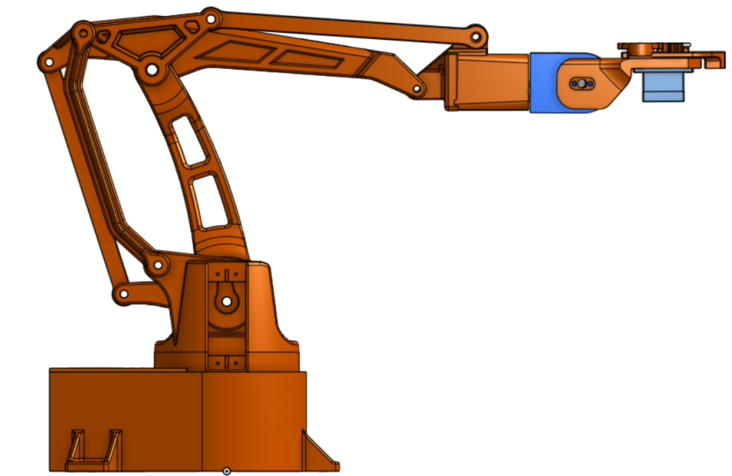
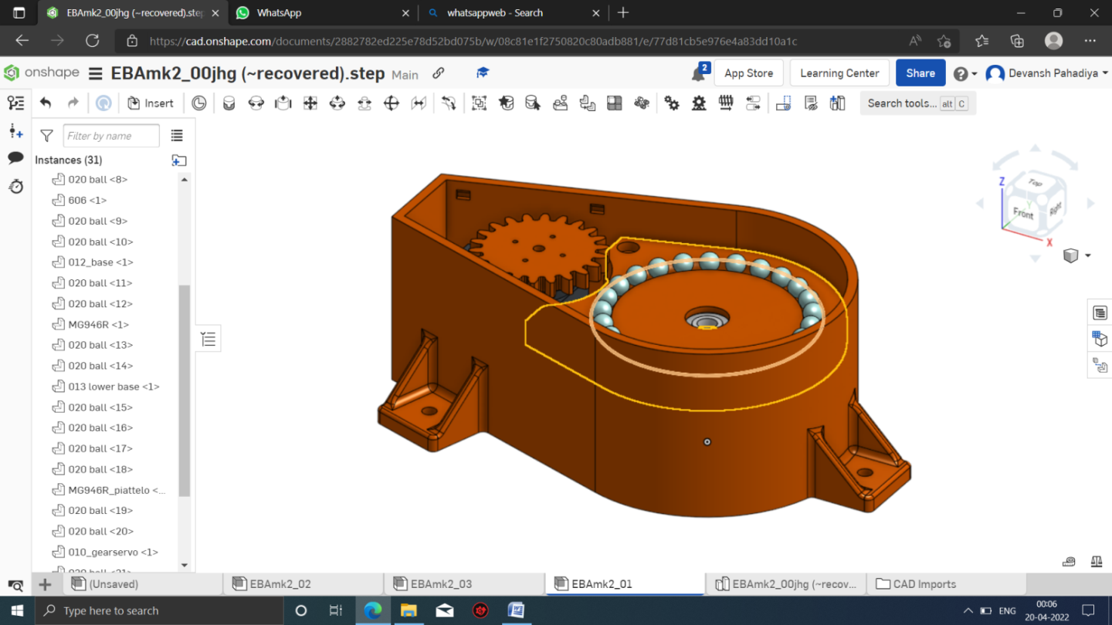
3d Model

Slide 8
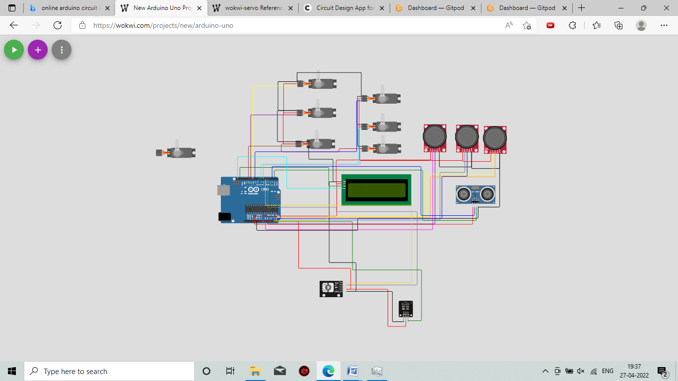
Circuit Diagram

Slide 9
3d Printing
Time taken :- 37 hours
Infill- 30 %
Infill Pattern :- Grid Mesh
Layer Height Used :- 0.2 mm
Nozzle Size :- 0.4 mm
Print Speed :- 40 mm/sec
Shell Thickness :- 1.2 mm
Base Thickness :- 1.2 mm
Material :- PLA
Support Structure :- Everywhere

Slide 10
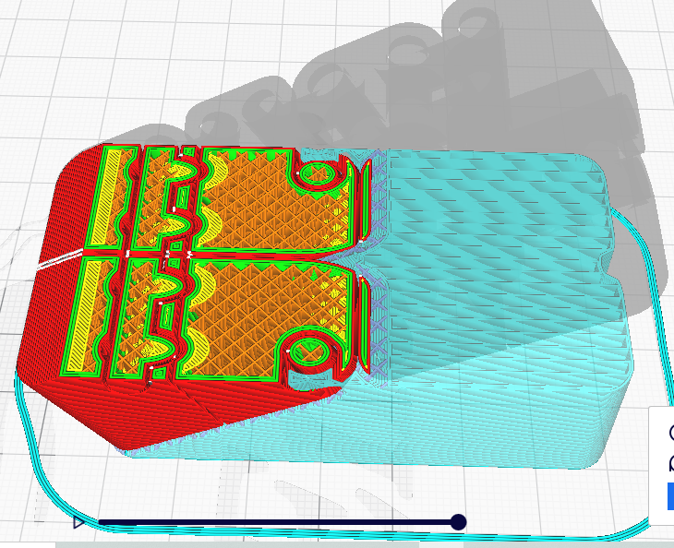
Figure -Slice Model in Cura

Slide 11
C Language
C is a general-purpose, high-level language that was originally developed by Dennis M. Ritchie to develop the UNIX operating system at Bell Labs. C was originally first implemented on the DEC PDP-11 computer in 1972.
It can be defined by the following ways:
Mother language
System programming language
Procedure-oriented programming language
Structured programming language
Mid-level programming language

Slide 12
Construction
Designing the components as per the requirements
Animating the Joints to check the motion of the robotic arm
3d printing the mechanical Components.
Post processing the 3d Printed Parts.
Checking the electronics components with Arduino with the test codes
Assembling the electronics components in the 3d printed parts.
Connecting the electronics components as per the circuit.
Uploading Sketch file by using Arduino IDE.
Compiling the different Sketch files one by one to make the final Sketch

Slide 13
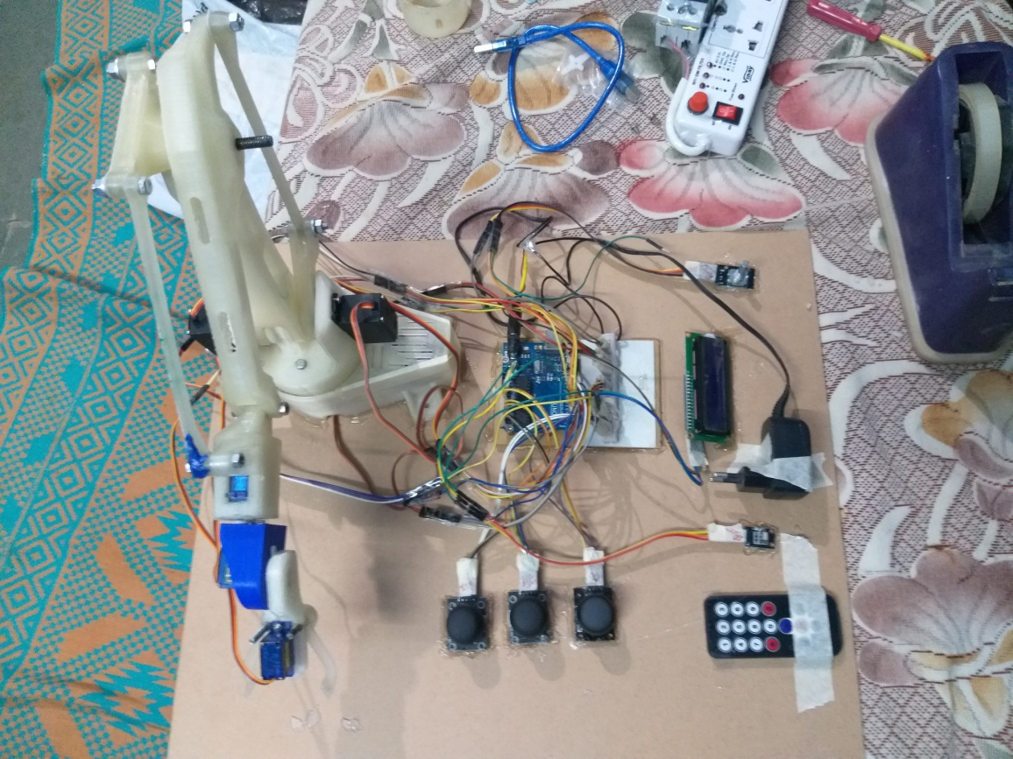
Figure :- Photo taken after Completion of V2 Arm

Slide 14
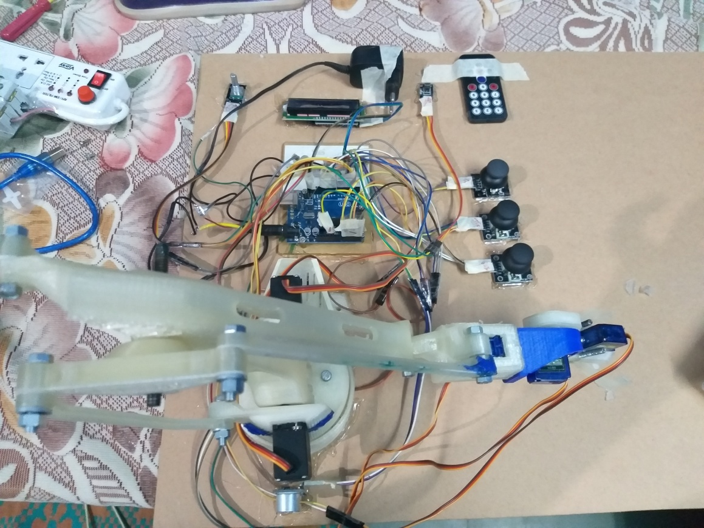
Figure :- Photo taken after Completion of V2 Arm-2

Slide 15


Slide 18
BIBLIOGRAPHY
Kanetkar, Yashavant. Let us C. BPB publications, 2018.
Low, Ting Sheng. SCARA Robot Kinematics And Simulation. Diss. Tunku Abdul Rahman University College, 2018.

Slide 19
Thank You

